Slide 1
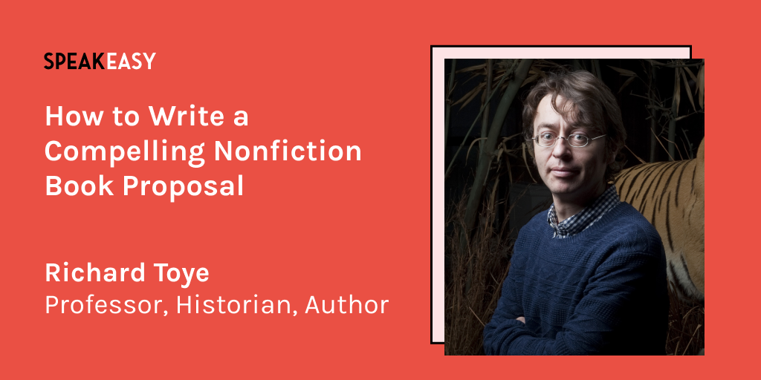

Slide 2
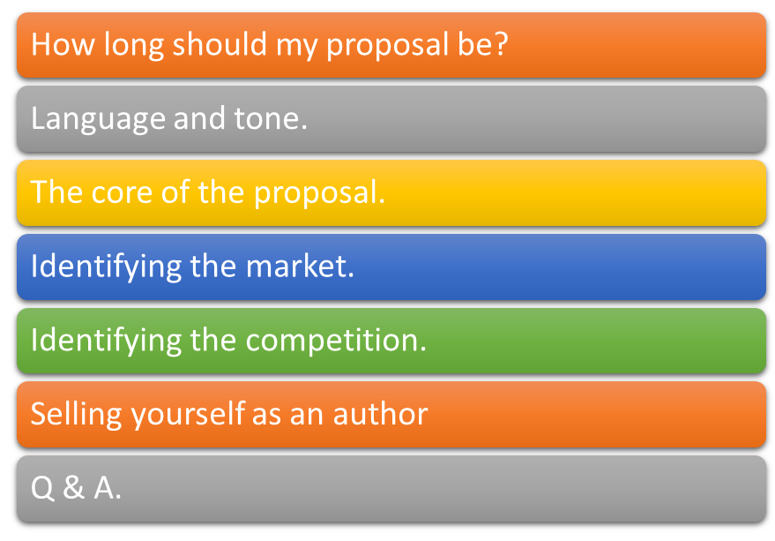
Session 2: The nitty-gritty

Slide 3

The basics
How long should the proposal be? (Between 10 & 30 pages).
Should I include sample material?
Do I need to use the publisher’s form?
When should I send in a proposal?

Slide 4
The substance of the proposal
1. Title and subtitle. Key differences between academic and trade books.
2. Brief description of project’s scope and content. Include key selling points – and your Why This, (Why Me), Why Now statement.
3. Proposed content. Chapter by chapter synopsis (probably). Try to limit yourself to one paragraph per chapter (for an academic proposal); keep paragraphs of roughly equal length.

Slide 5
Language and tone
Be as positive and dynamic as possible while avoiding hyperbole.
Useful words: “key”, “vital”, “novel”, “compelling”, “challenges X”, “groundbreaking”, “powerful”, “revelatory” (and for trade books), “gripping narrative”, “fast-paced”, “rich in anecdote”, “dramatic human story”.
Use the proposal to give the reader a sense of what it would be like to read the book.

Slide 6


Identifying the market
Deploy evidence of interest in the topic
Main audience for the work – academics, students, practitioners, general readers?
What is (are) the subject area(s)?
Mention scholarly societies, professional bodies, etc.
Be realistic but rack your brains for all possible markets.

Slide 7
Competition
This is not a literature review.
No need to attack/undermine other works.
This is to give a frame of reference.

Slide 8
Additional information
Length (in thousands of words).
Has any of your work included in this manuscript been published previously? Is the book based on your PhD? If so, is your thesis available electronically?
Delivery date.

Slide 9
Author information
For an academic book you may be asked to submit your CV.
But you still need a short, punchy bio paragraph.
“I am Professor of Modern history at the University of Exeter. I have published 19 non-fiction books on historical topics and was the co-presenter of the 2018 Channel 4 documentary Churchill's Secret Affair. I have written for the Guardian, the New York Times, and many other publications. In 2007 I won the Times Higher Education Young Academic of the Year Award for my book Lloyd George and Churchill: Rivals for Greatness. Mick Jagger once revealed in an interview that he has one of my books on his Kindle.”
Give social media stats (if they’re impressive).

Slide 10
Dealing with referee/editorial comments
Address everything.
Don’t get mad – get even.
Accept suggestions if you reasonably can.
But don’t give hostages to fortune.
Try to say “Yes, but” rather than “No”.

Slide 11
If offered a contract …
Consider joining Society of Authors and using their contract-reading service (if you have doubts).
Think about negotiating …
Indexing costs.
Images and costs of images.
Paperback.

Slide 12

Routes to trade publication
Keep telling people about your project.
Approach trade editors directly.
Note the OUP “Impact” series.
Consider proposing an OUP Very Short Introduction.

Slide 13
If at first you don’t succeed …
Make use of any feedback.
Try other publishers.
But I think you probably will succeed quite quickly!

Slide 14


